Slide 1
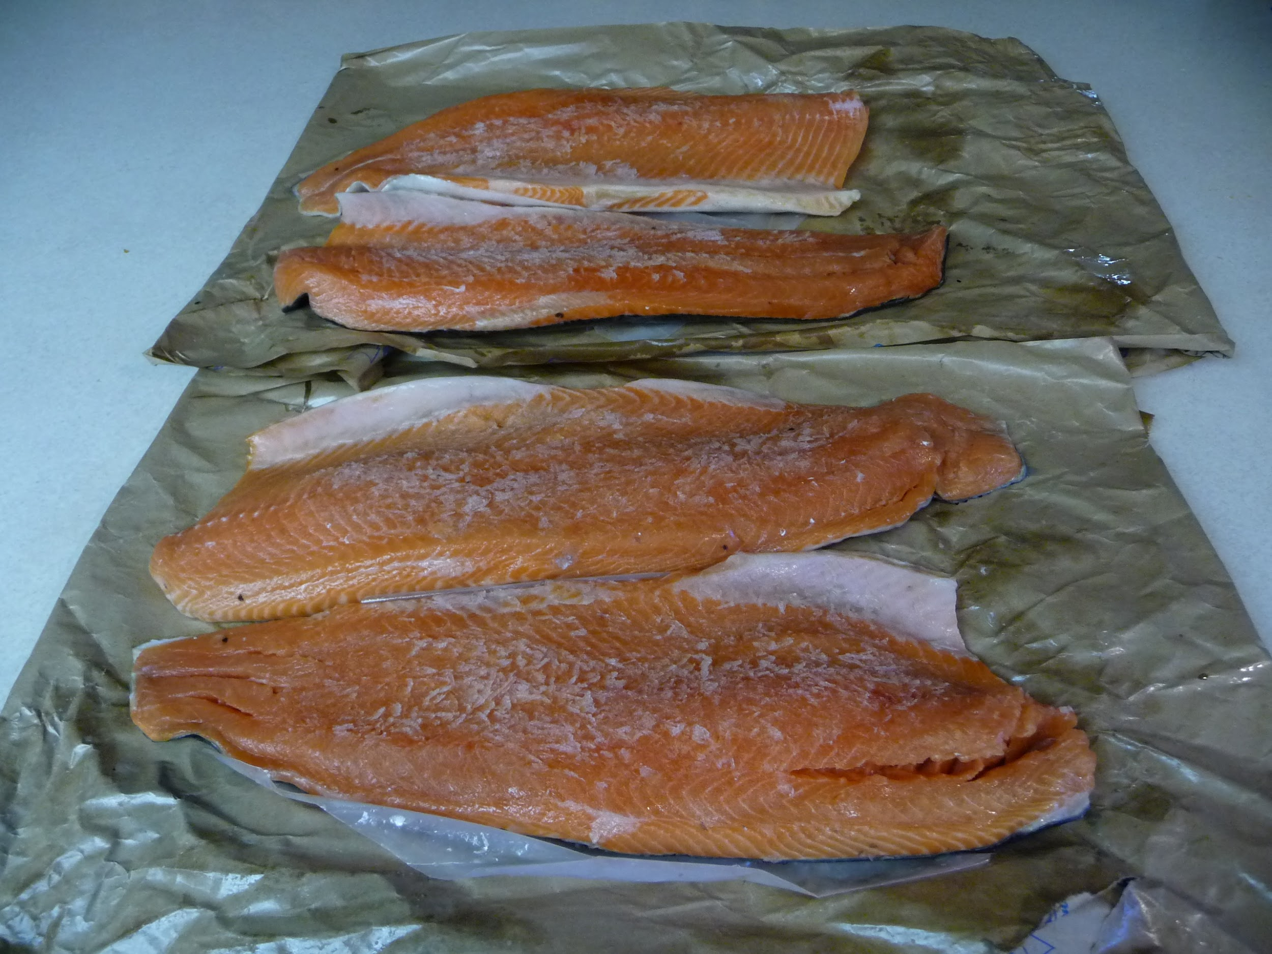
Smoked Salmon
http://signupbackyardsmokedmeats.gr8.com/
The step by step I use to smoke the best Salmon ever
Notes:
This is four Atlantic filets

Slide 2
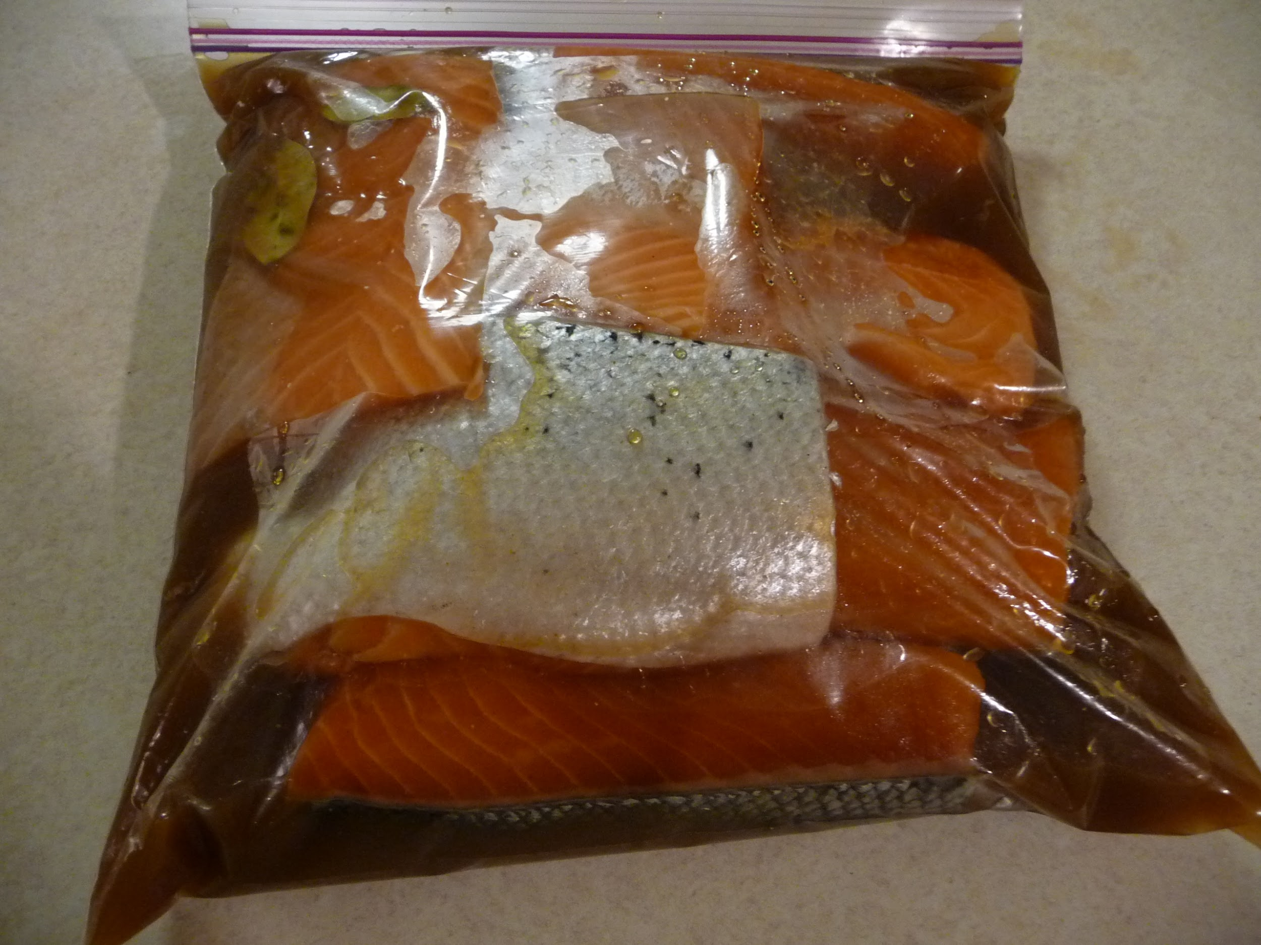
Brimmed for six hours

Slide 3
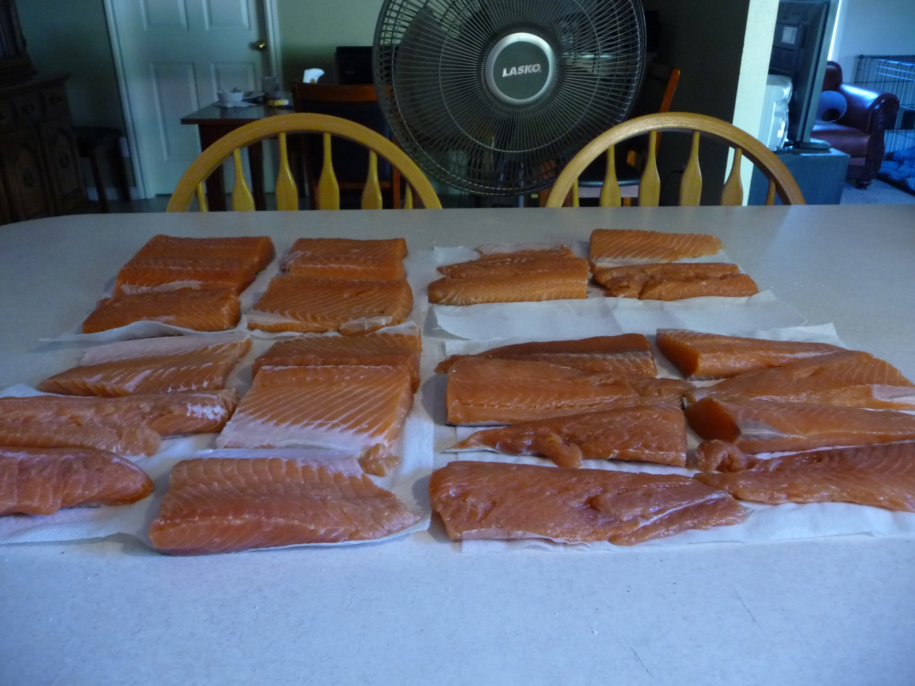
Air dried for two hours by fan
fan
Notes:
After brimming for six hours rinse thoroughly. While fillets are drying spray the
racks with olive oil. Place fillets on racks to finish drying.

Slide 4
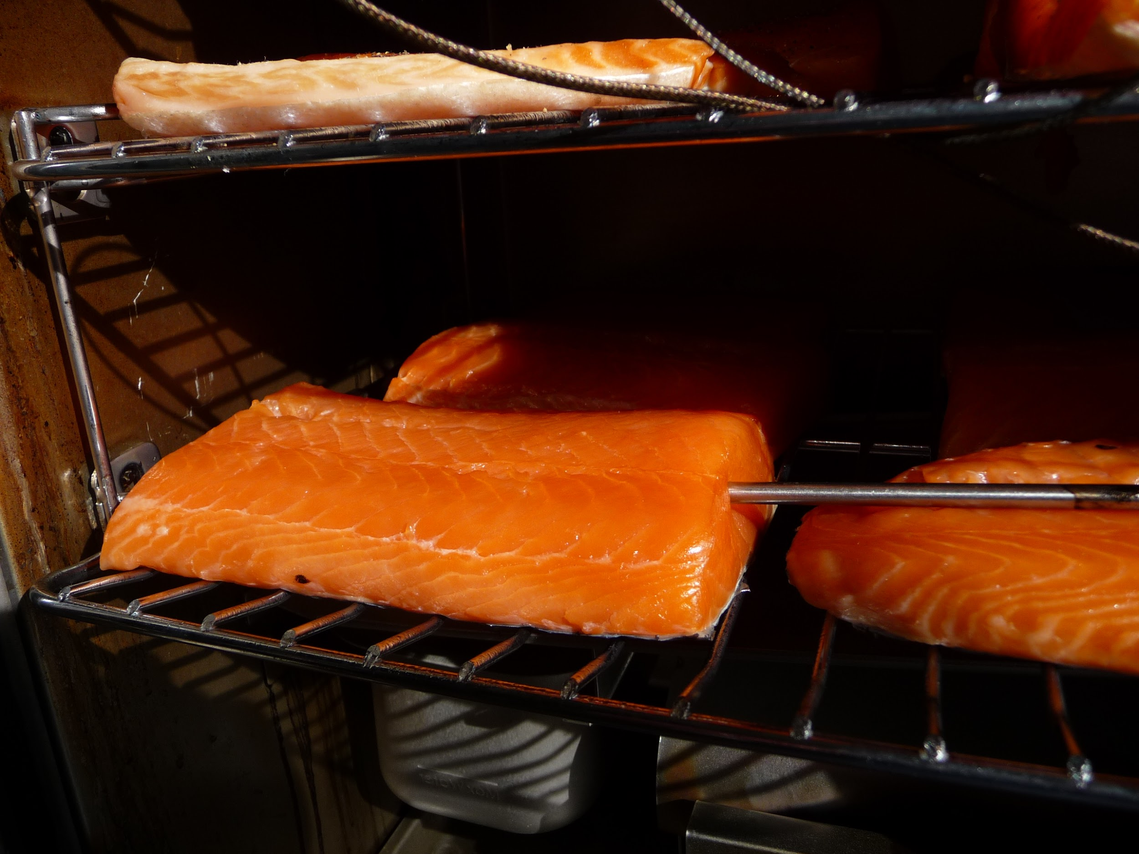
Set on racks with smallest pieces on top
Notes:
and thicker pieces in the middle with the thickest pieces at the bottom

Slide 5
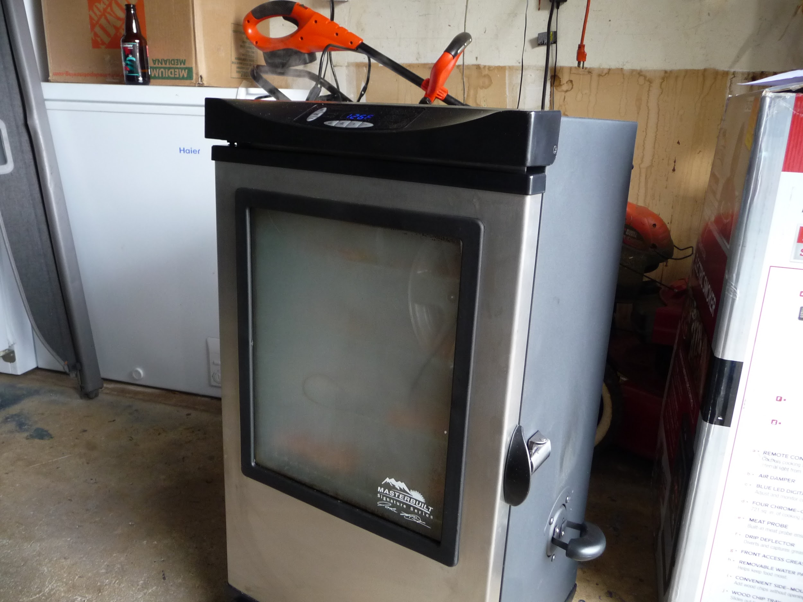
Smoke for one hour at 100*

Slide 6
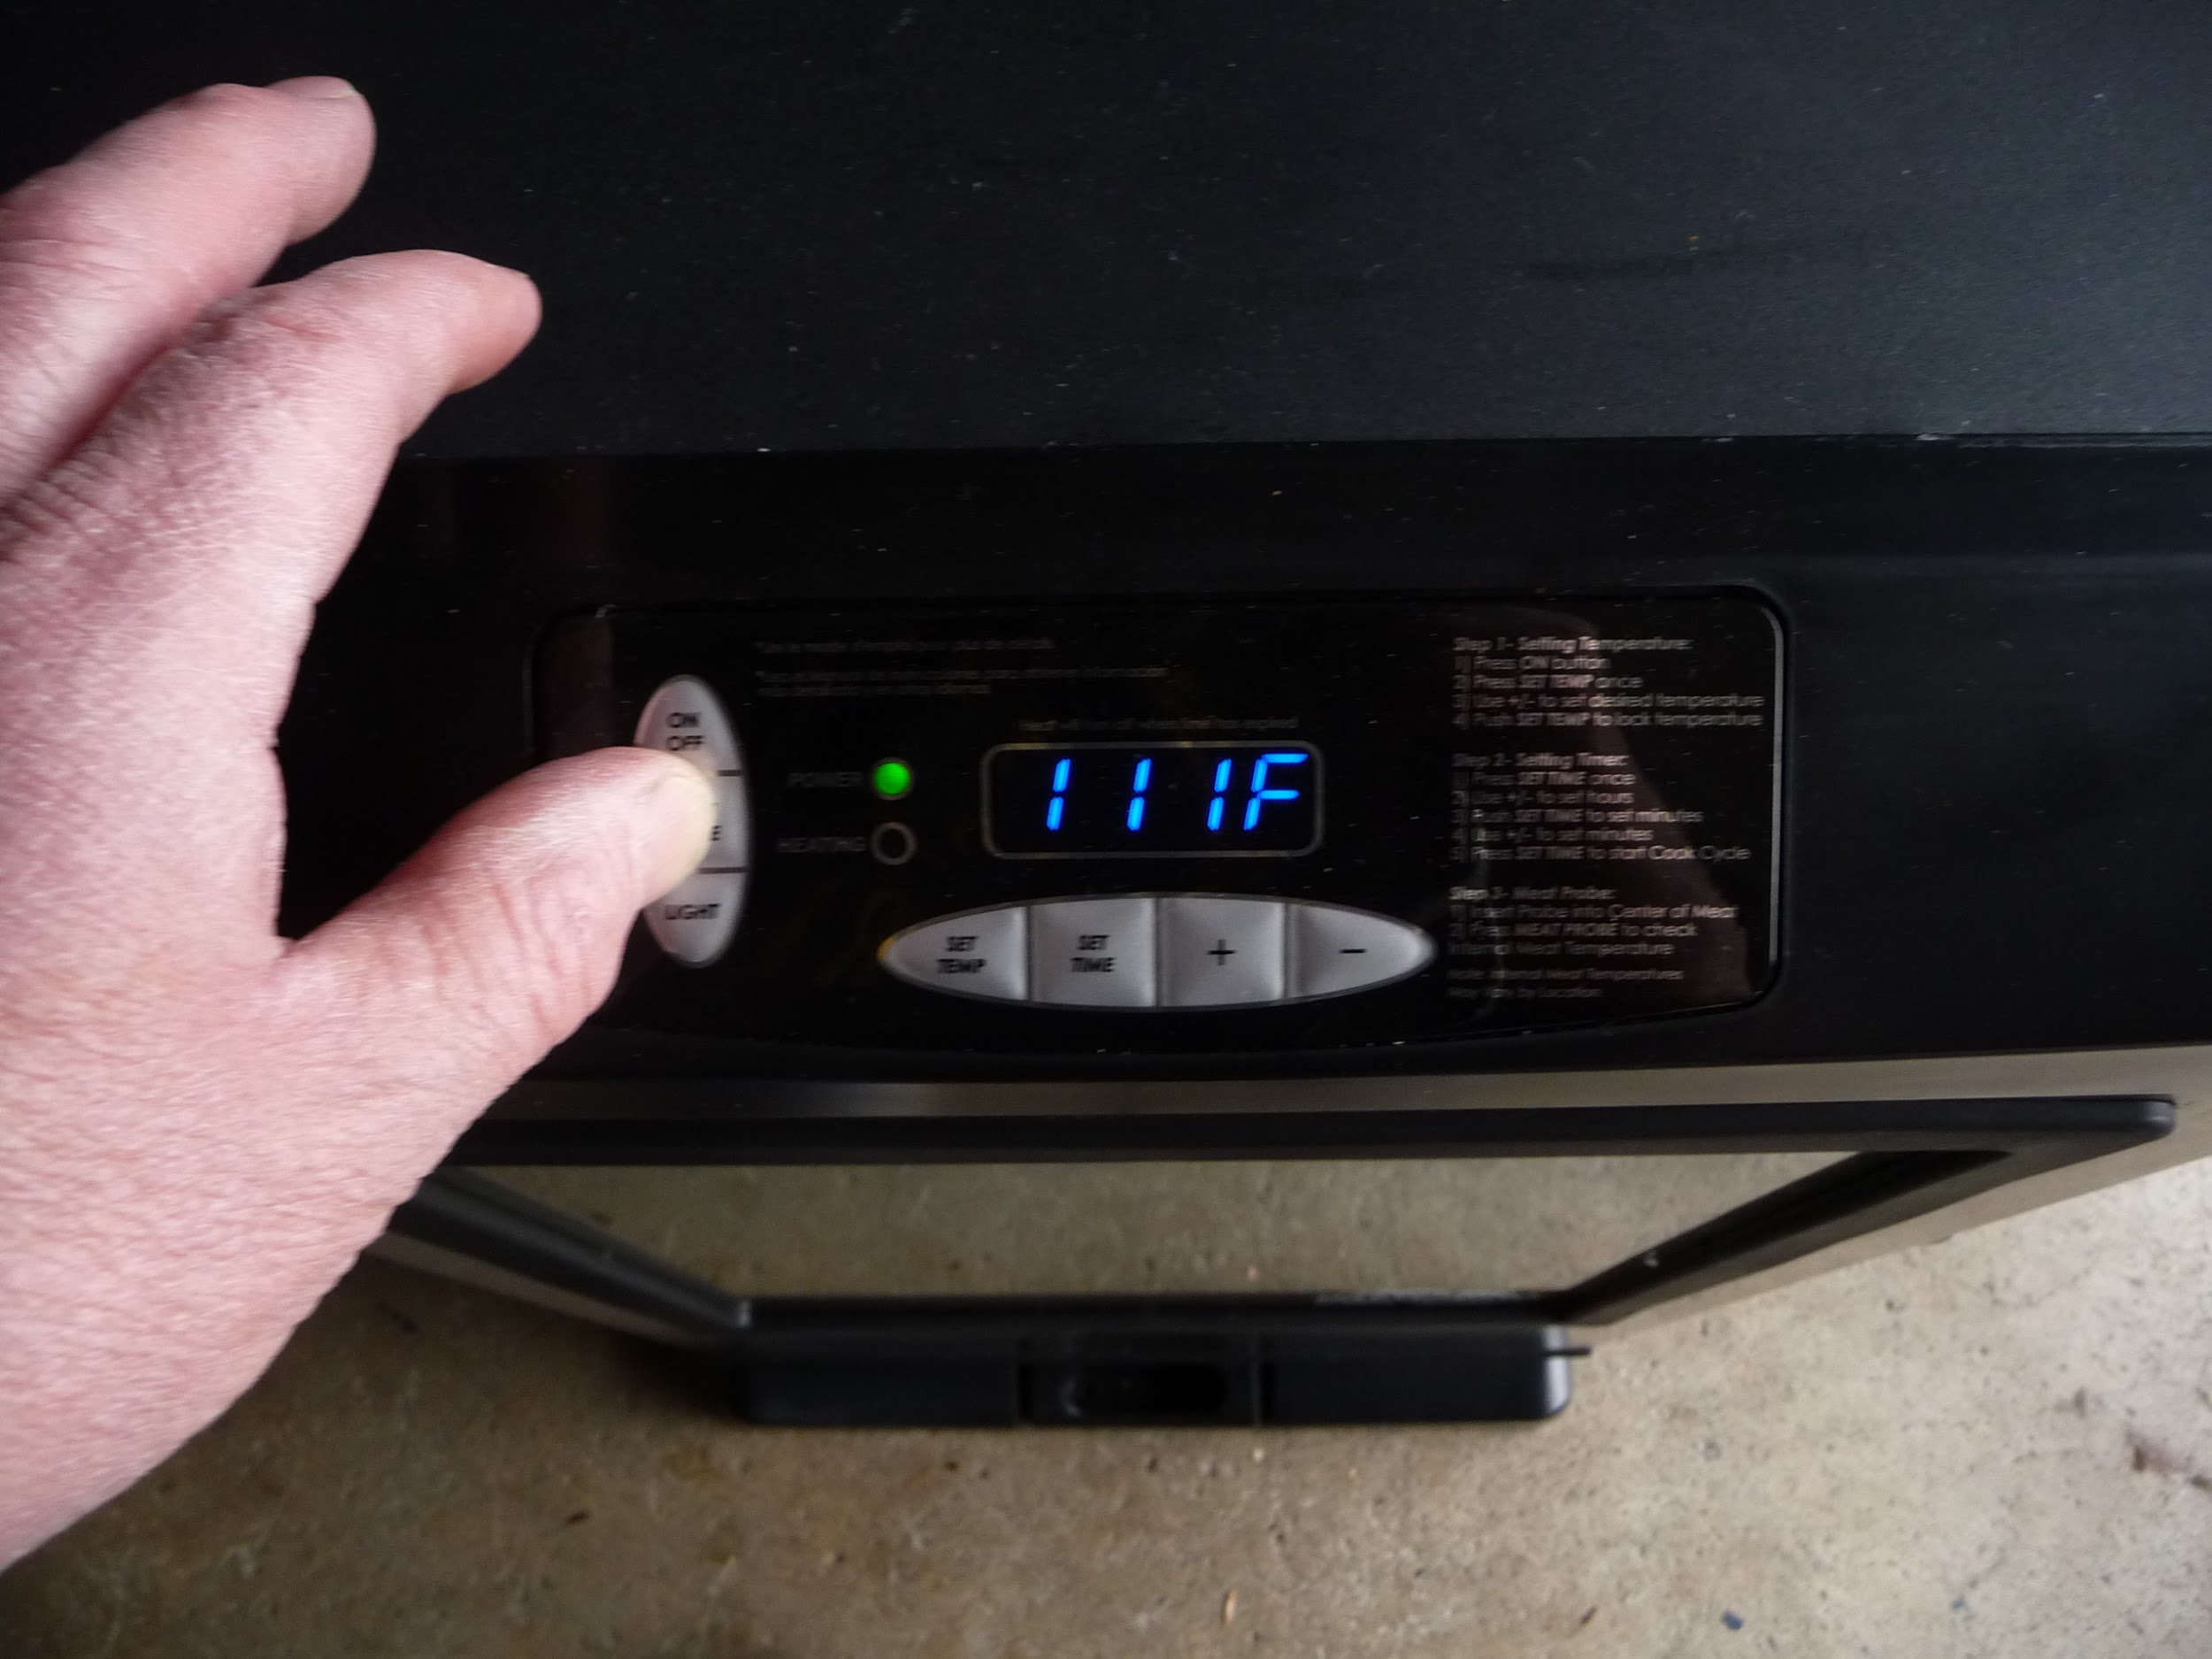
Up temp to 140*/160*/180 in half hour intervals

Slide 7
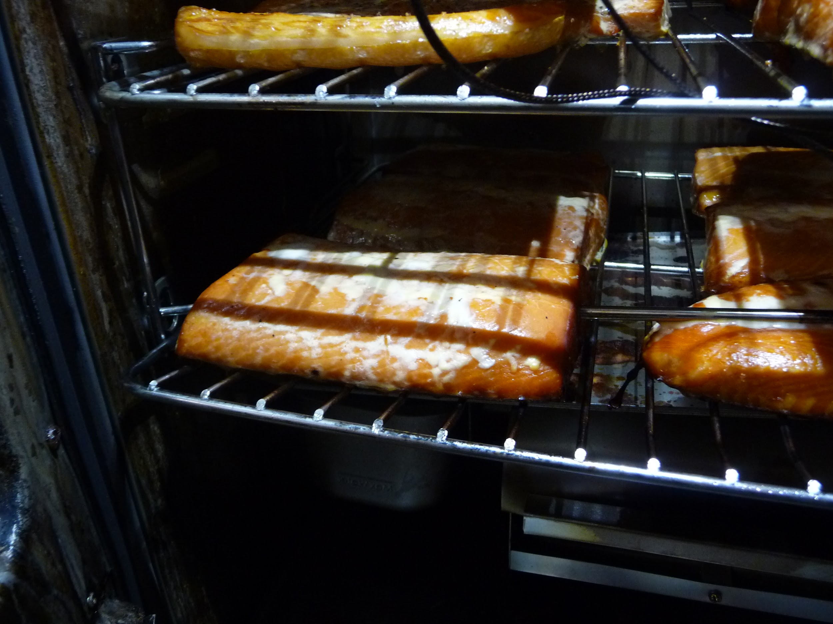
crank up smoker to 200* for last hour.cook till internal temp is 140*

Slide 8
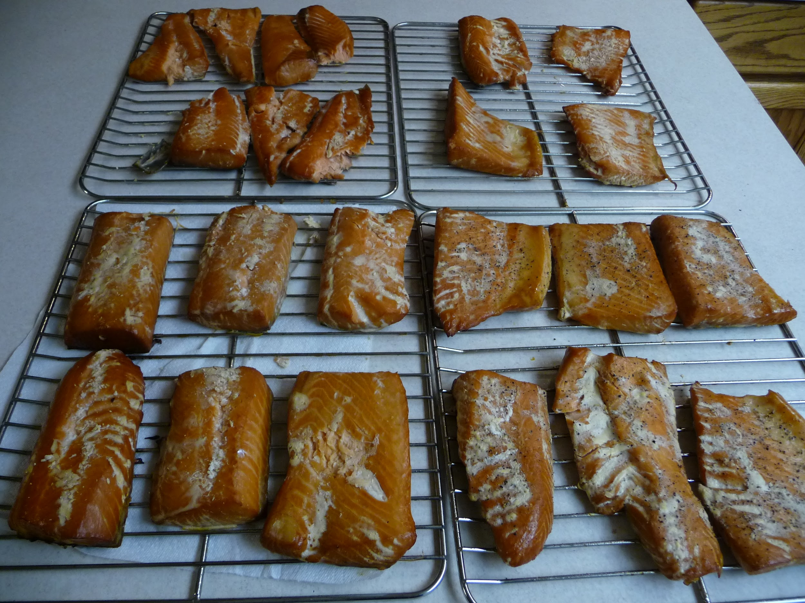
Cool down and put in fridge over night

Slide 9
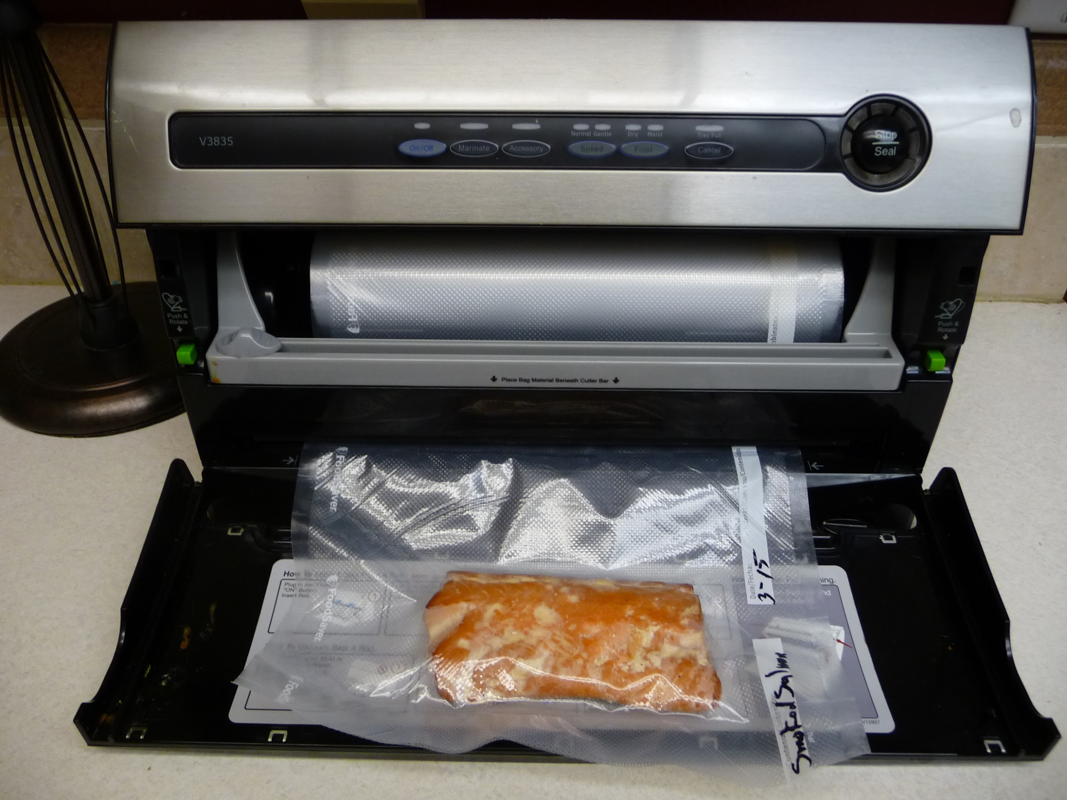
Cryovac enjoy smoked Salmon

Slide 10
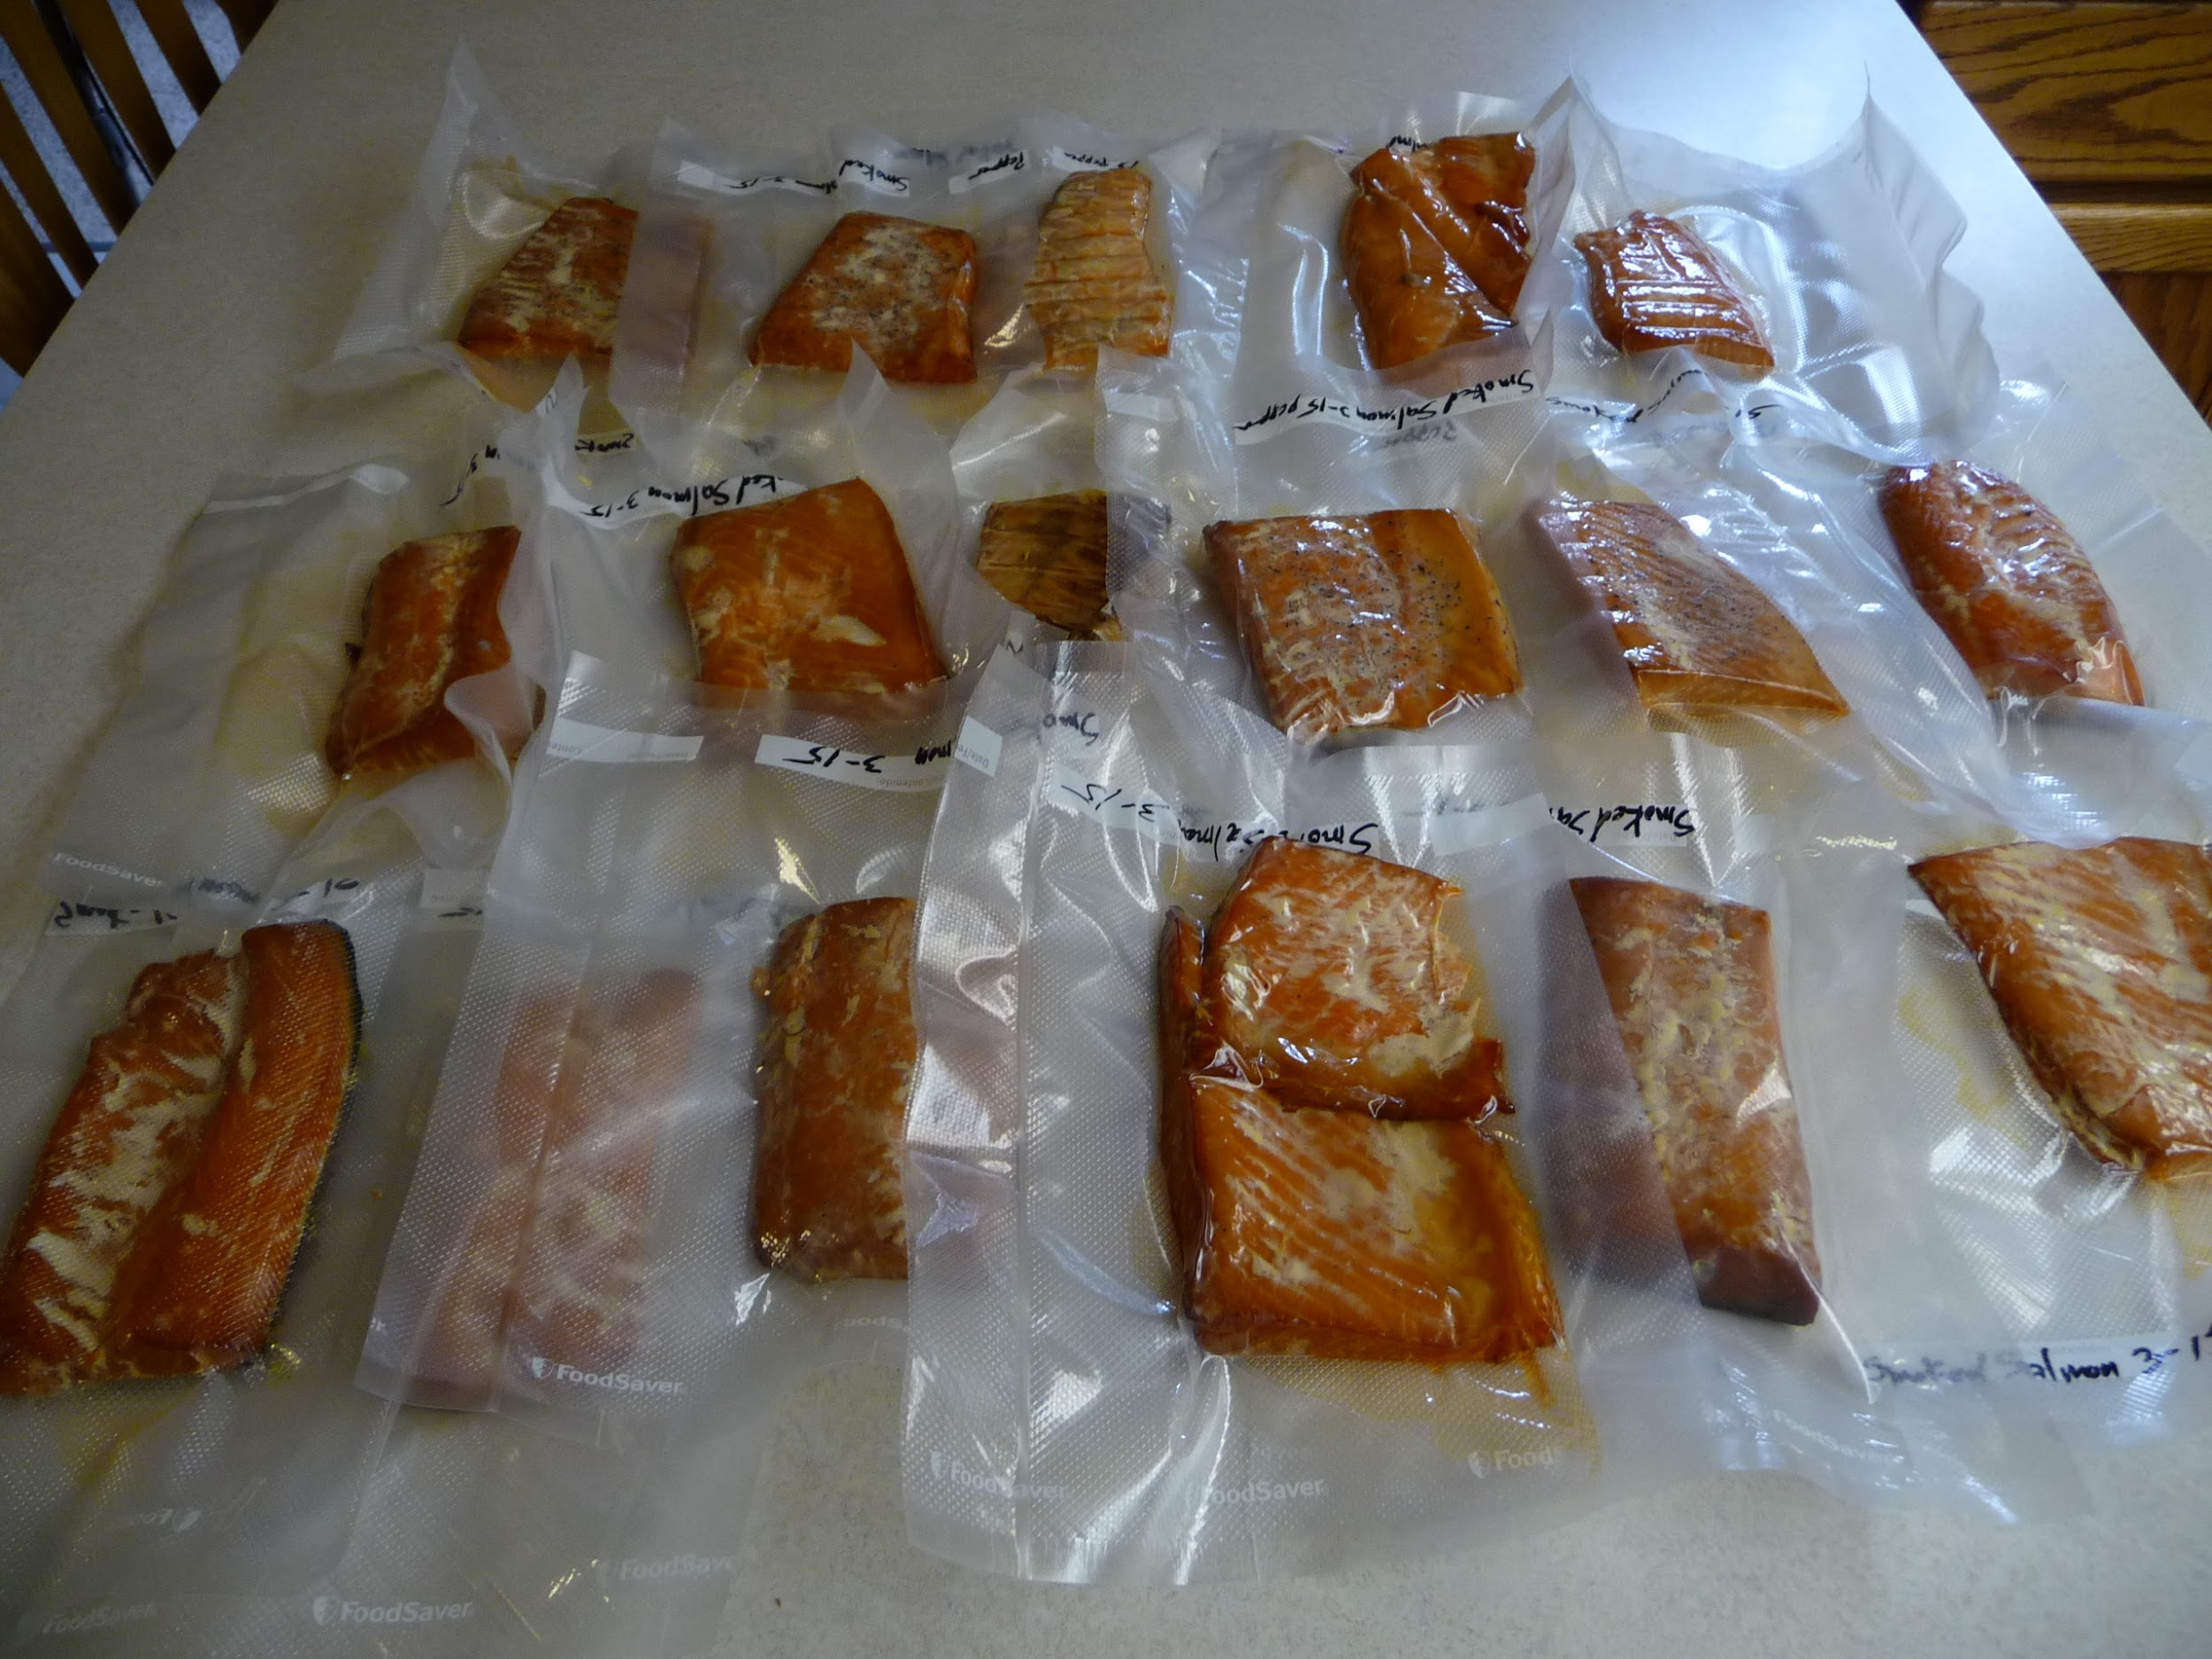
Final product

